Slide 1
Module 5: Implement Load Balancing and Network Security
Azure Load Balancer, Application Gateway, Azure Firewall, and Azure Traffic Manager

Slide 2

Learning Objectives
You will learn the following:
Implement Azure Load Balancer
Implement an Application Gateway
Web Application Firewall
Implement Azure Firewall
Implement Azure Front Door
Implementing Azure Traffic Manager
Implement Network Security Groups and Application Security Groups
Implement Azure Bastion

Slide 3
Implement Azure Load Balancer

Slide 4
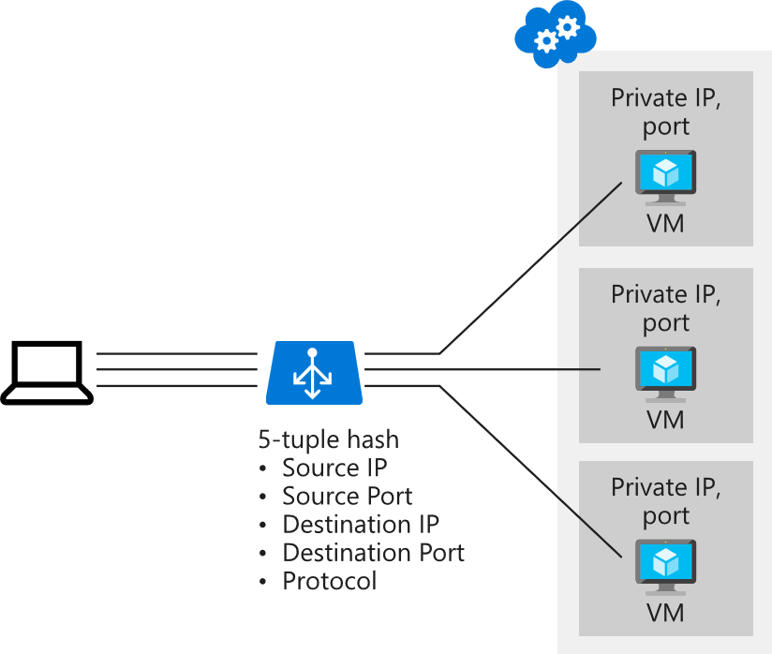

Distribute Traffic with Azure Load Balancer (1 of 3)
Distribute traffic with Azure load balancer based on
Source IP
Source port
Destination IP
Destination port
Protocol type

Slide 5
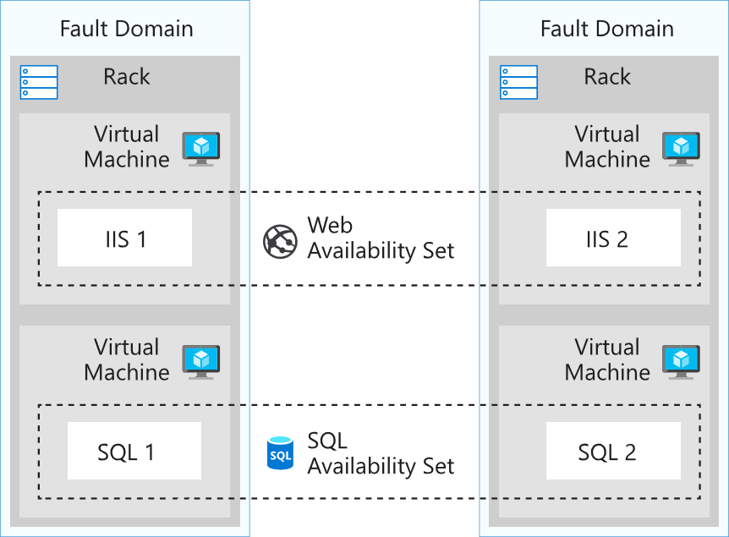
Distribute Traffic with Azure Load Balancer (2 of 3)
Availability sets

Slide 6
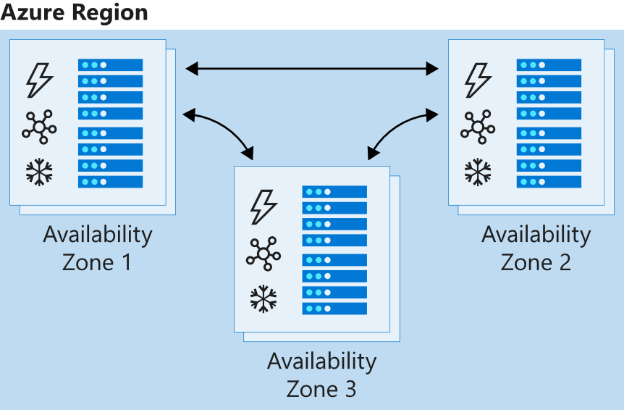
Distribute Traffic with Azure Load Balancer (3 of 3)
Availability zones

Slide 7
Select a Load Balancer Solution
Basic load balancers allow:
Port forwarding
Automatic reconfiguration
Health probes
Outbound connections through source network address translation (SNAT)
Diagnostics through Azure Log Analytics for public-facing load balancers
Standard load balancers support all basic features and allow:
HTTPS health probes
Availability zones
Diagnostics through Azure Monitor, for multidimensional metrics
High availability (HA) ports
Outbound rules
A guaranteed SLA (99.99% for two or more virtual machines in different zones)

Slide 8
Configure a Public Load Balancer (1 of 3)
Distribution mode
Five-tuple hash

Slide 9
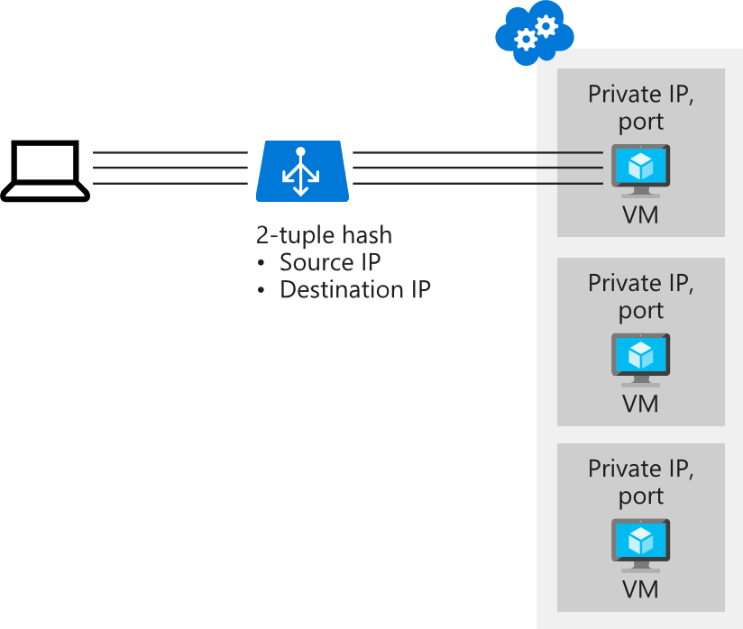
Configure a Public Load Balancer (2 of 3)
Distribution mode
Source IP affinity

Slide 10
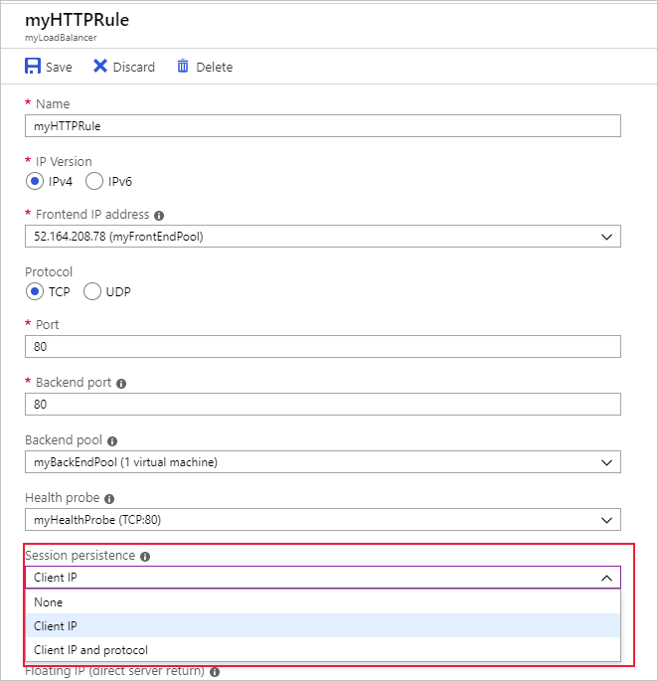
Configure a Public Load Balancer (3 of 3)
Choose a distribution mode
None
Client IP (use for Remote Desktop Gateway)
Client IP and protocol

Slide 11
Demonstration: Create a Load Balancer to Load Balance VMs
Create a load balancer
Create load balancer resources
Create virtual machines
Create NSG rule
Install IIS
Test the load balancer

Slide 12
Implement an Application Gateway

Slide 13
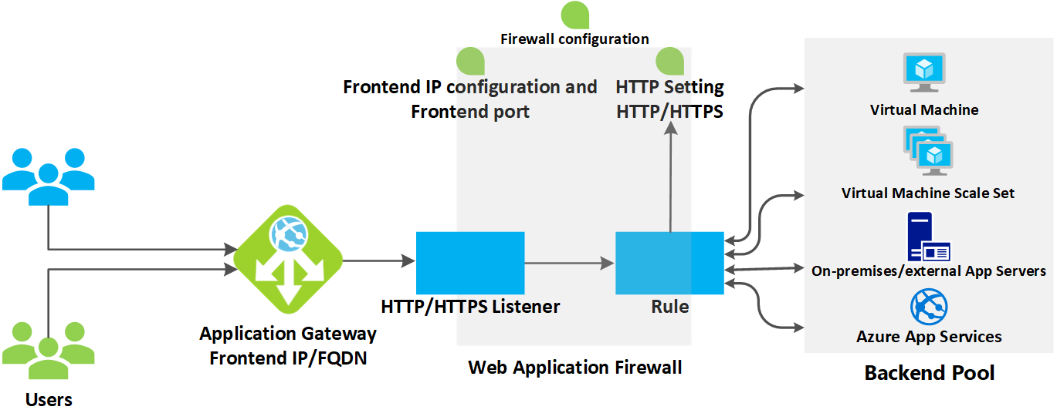
Application Gateway (1 of 2)
How an application gateway accepts a request

Slide 14
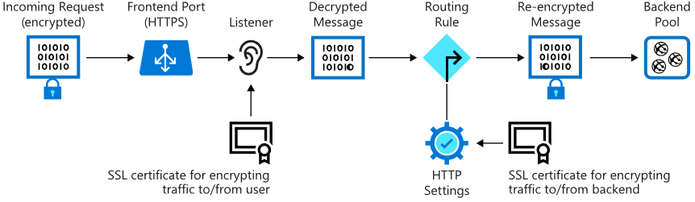
Application Gateway (2 of 2)
Application gateway components:
Frontend port and listener
Backend pool

Slide 15
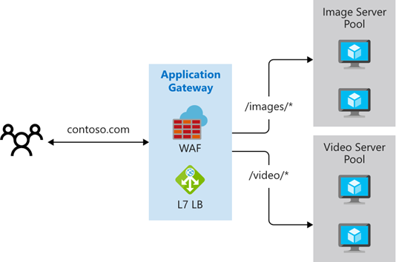
Application Gateway Routing (1 of 3)
Path-based routing

Slide 16
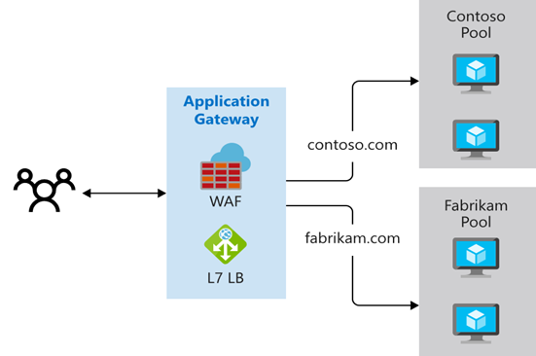
Application Gateway Routing (2 of 3)
Multiple site routing

Slide 17
Application Gateway Routing (3 of 3)
Additional features:
Redirection
Rewrite HTTP headers
Custom error pages

Slide 18
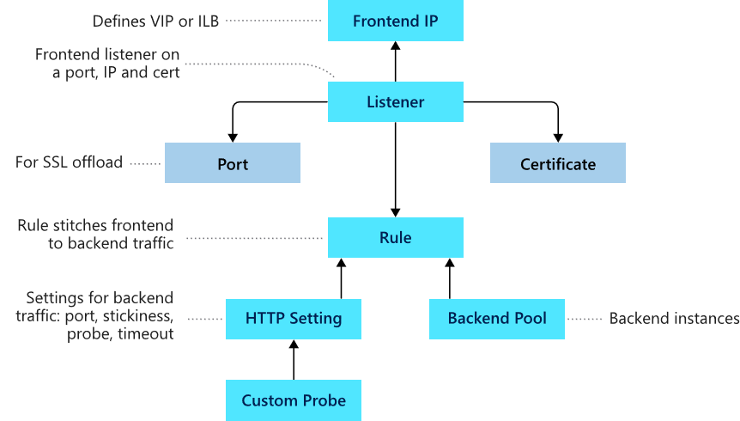
Application Gateway Configuration
Front-end IP address
Listeners
Routing rules
Back-end pools
Web application firewall
Health probes

Slide 19
Web Application Firewall

Slide 20
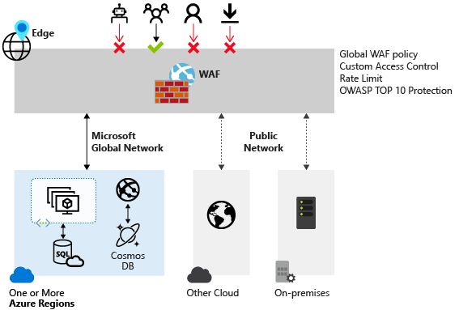
Web Application Firewall Overview (1 of 2)
Web Application Firewall (WAF)
Notes:
Instructor Note: Rate limiting can be used wherever WAF policy can be applied, but rate limiting only usable for Front Door and CDN.

Slide 21
Web Application Firewall Overview (2 of 2)
Supported services:
Azure Application Gateway
Azure Front Door
Azure Content Delivery Network (preview)

Slide 22
Demonstration: Create an application gateway with a web application firewall
Create an application gateway

Slide 23
Implement Azure Front Door

Slide 24
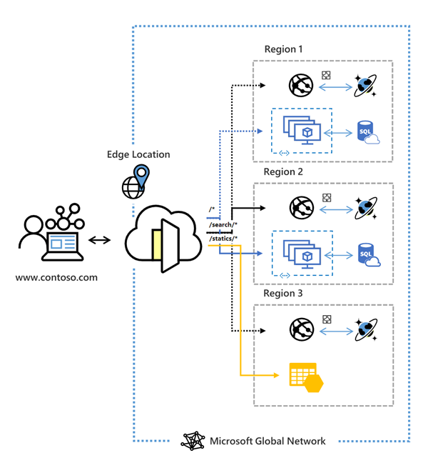
Azure Front Door
Accelerate application performance
Increase application availability with smart health probes
URL-based routing
Multiple-site hosting
Session affinity
TLS termination
Custom domains and certificate management
URL redirection
URL rewrite
Protocol support – IPv6 and HTTP/2 traffic

Slide 25
Demonstration: Create an Azure Front Door
Create an Azure Front Door
View Front Door in action

Slide 26
Implementing Azure Traffic Manager

Slide 27
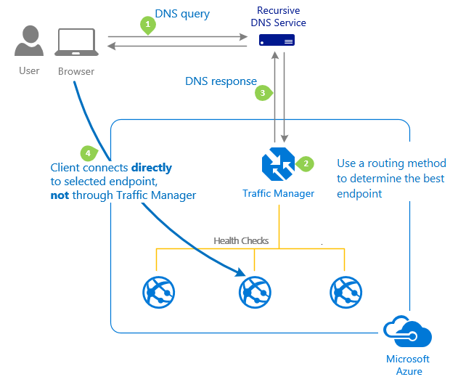
Azure Traffic Manager
Works by using DNS to direct requests to the most appropriate endpoint
Selects endpoints based on configured traffic routing method
Provides endpoint health checks and automatic failover

Slide 28
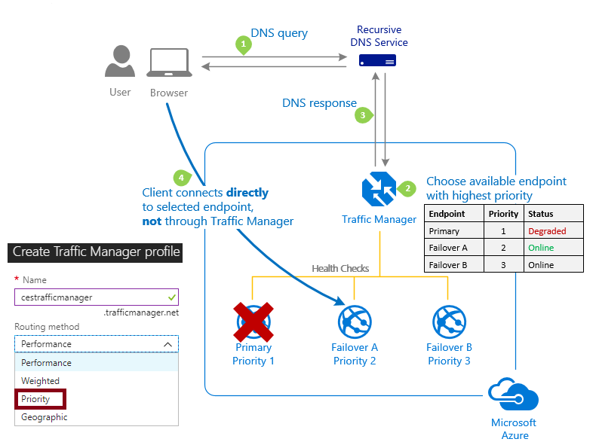
Traffic Manager Routing Methods (1 of 4)
Priority routing

Slide 29
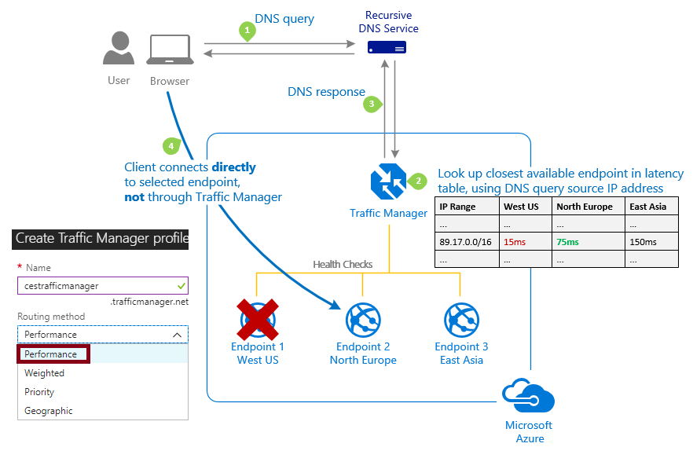
Traffic Manager Routing Methods (2 of 4)
Performance routing

Slide 30
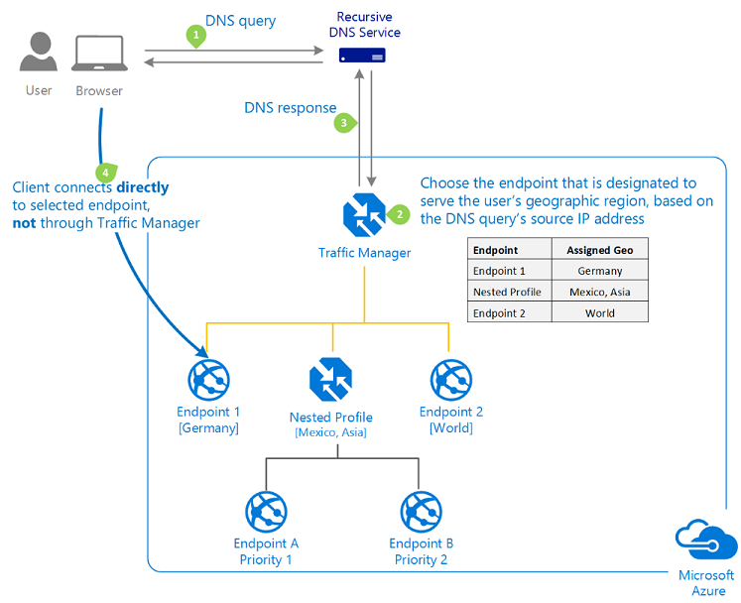
Traffic Manager Routing Methods (3 of 4)
Geographic routing

Slide 31
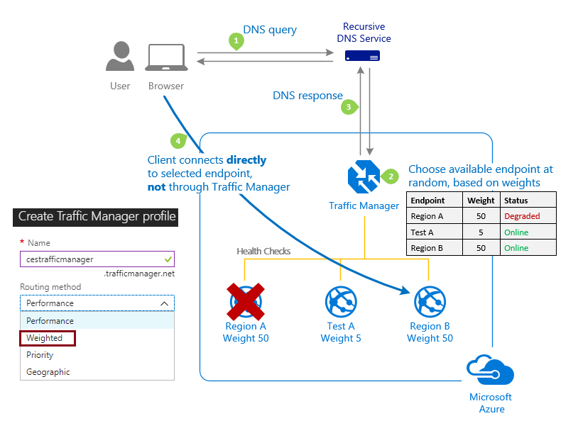
Traffic Manager Routing Methods (4 of 4)
Weighted routing

Slide 32
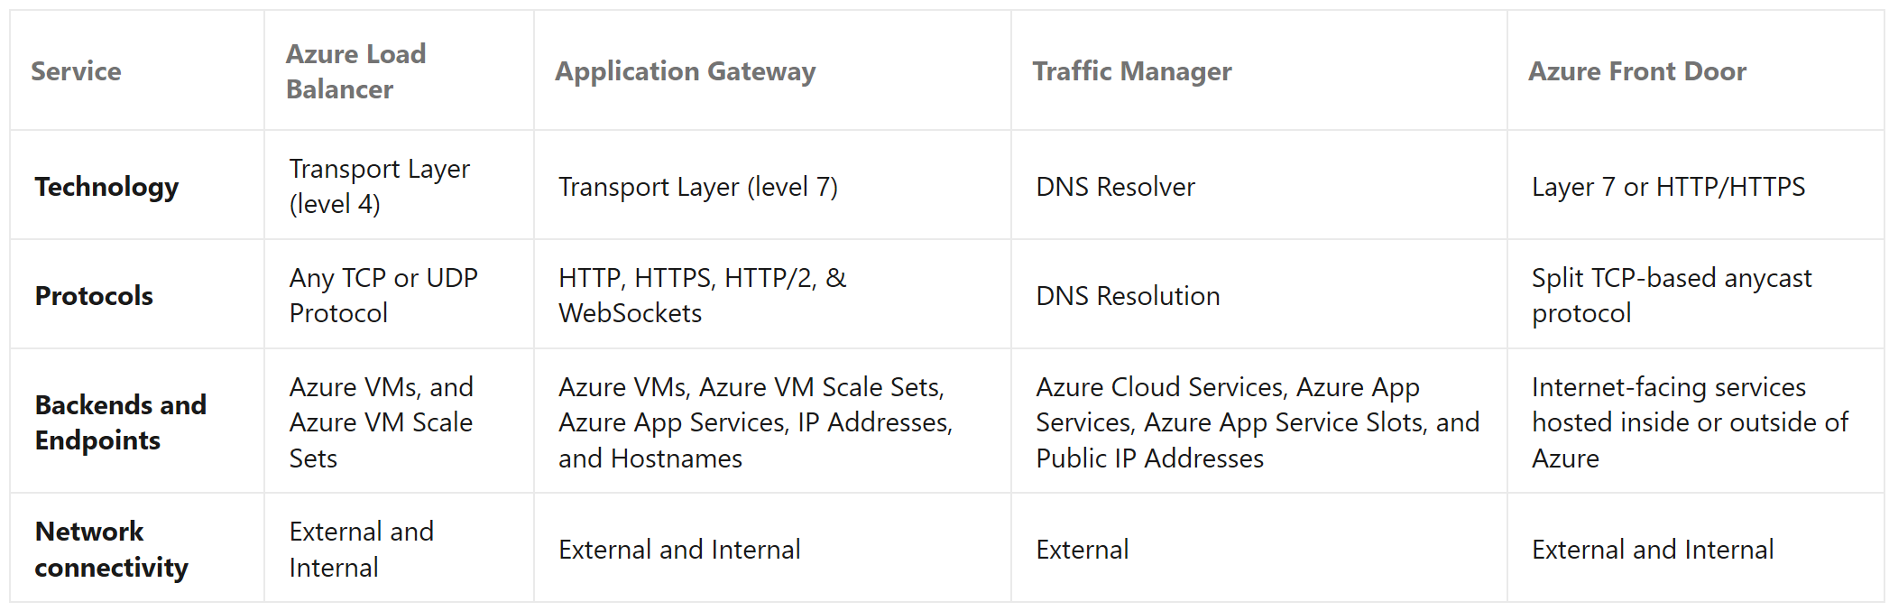
Distributing Network Traffic
Compare the Azure Load Balancer with Traffic Manager

Slide 33
Implement Azure Firewall

Slide 34
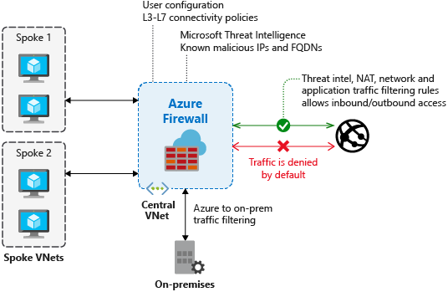
Azure Firewall
Azure Firewall features:
Built-in high availability
Availability zones
Unrestricted cloud scalability
Application FQDN filtering rules
Network traffic filtering rules
Threat intelligence
Multiple public IP addresses

Slide 35
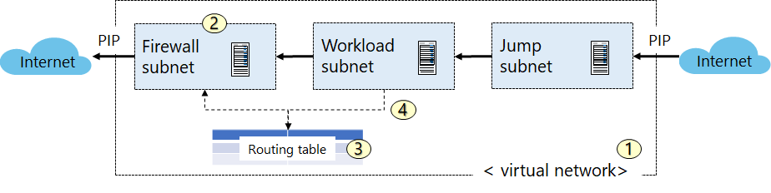
Implementing Azure Firewall
Create the network infrastructure
Deploy the firewall
Create a default route
Configure an application rule

Slide 36
Demonstration: Deploy Azure Firewall
Set up a network
Create virtual machines
Deploy the firewall

Slide 37
Implement Network Security Groups and Application Security Groups

Slide 38
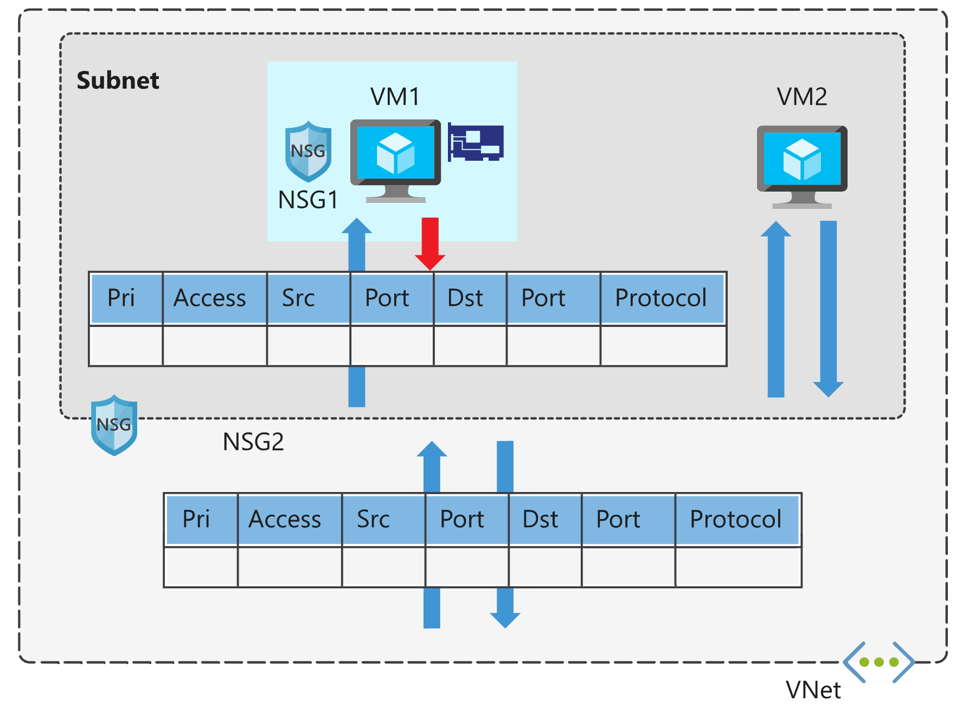
Network Security Groups (NSGs)
Network security group assignment and evaluation

Slide 39
Security Rules (1 of 2)
Rules properties:
Name
Priority
Source or destination
Protocol
Direction
Port range
Action
Augmented security rules allow you to add the following options to a rule:
multiple IP addresses
multiple ports
service tags
application security groups

Slide 40
Security Rules (2 of 2)
Service tags simplify defining rules by designating services such as:
VirtualNetwork
AzureLoadBalancer
Internet
AzureTrafficManager
Storage
SQL
AppService

Slide 41
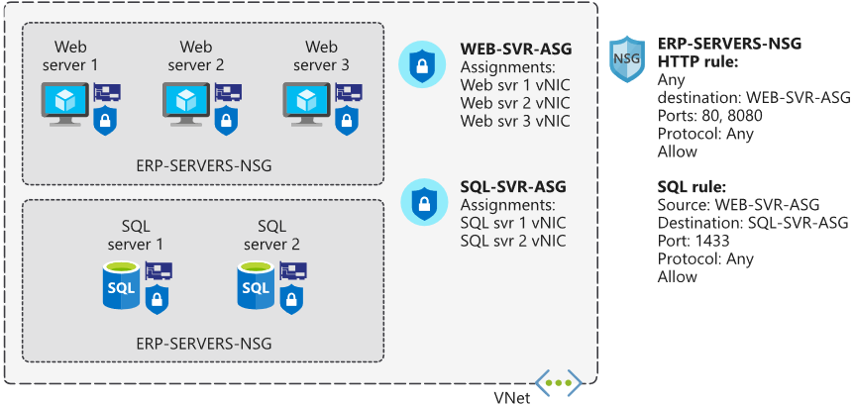
Application Security Groups
An application security group scopes a rule to a group of custom-defined resources

Slide 42
Implement Azure Bastion

Slide 43
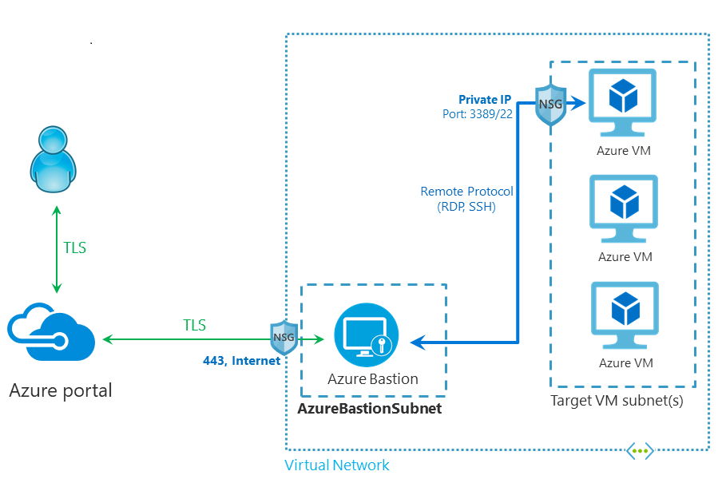
Azure Bastion (1 of 2)
Architecture

Slide 44

Azure Bastion (2 of 2)
Key features:
RDP and SSH directly in Azure portal
Remote session over TLS and firewall traversal for RDP/SSH
No Public IP required on the Azure VM
No hassle of managing NSGs
Protection against port scanning
Protection against zero-day exploits

Slide 45
Demonstration: Create an Azure Bastion host
Create a new Azure Bastion resource from the Azure portal

Slide 46
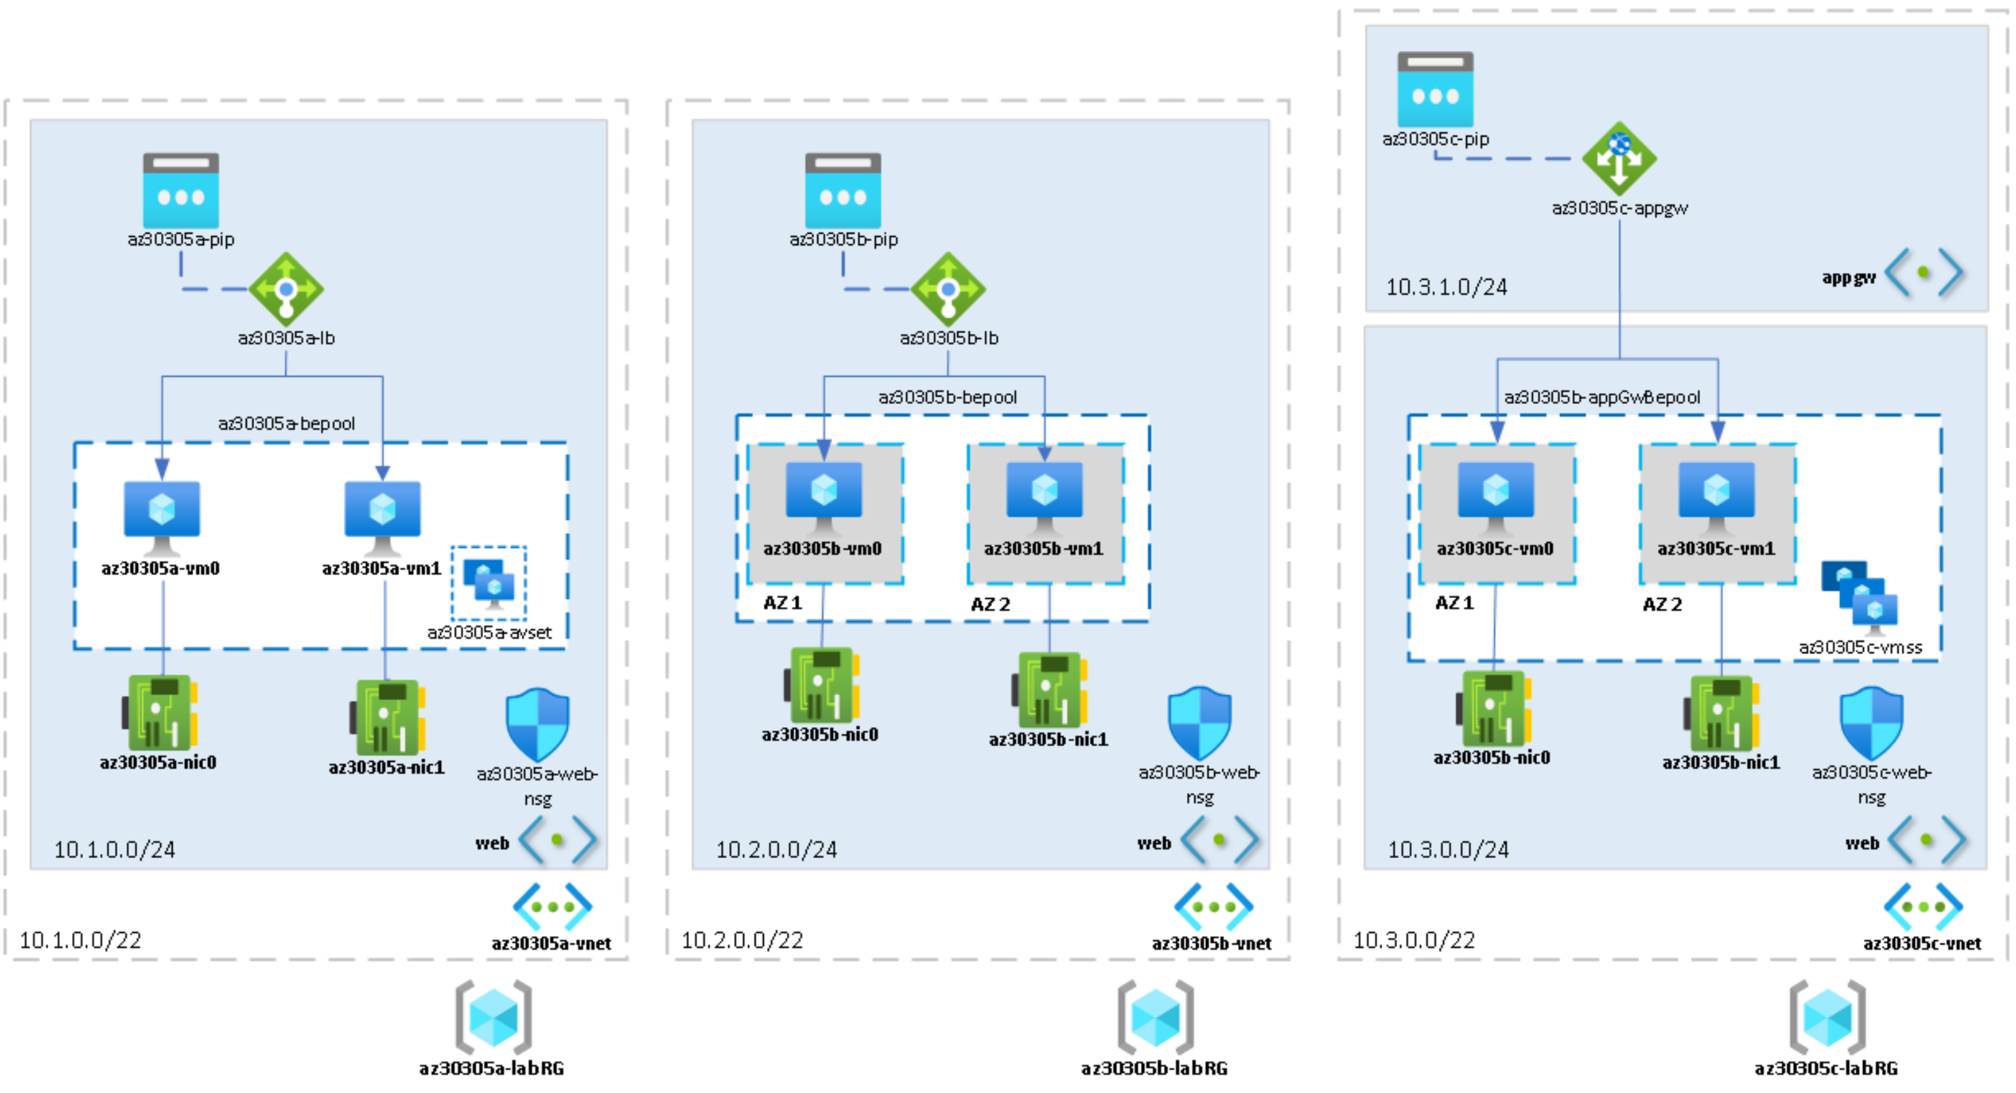
Lab: Implementing Highly Available Azure IaaS Compute Architecture

Slide 47

Module Review Questions

